Slide 1
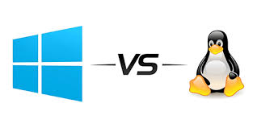
LINUX VS WINDOWS

Slide 2
Name: MD TAMIM HOSSEN SEFAT
ID: 19-39349-1 Section: A
Course: Introduction To Computer Studies
Faculty Name: SUPTA RICHARD PHILIP
Date: 11.12.19

Slide 3
CONTENTS
WHAT IS OPERATING SYSTEM?
DIFFERENT TYPES OF OPERATING SYSTEMS.
WINDOWS OS
VERSION OF WINDOWS
LINUX OS
VERSION OF LINUX
COMPARISON
CONCLUSION

Slide 4
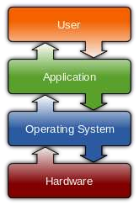
WHAT IS OPERATING SYSTEM?
An operating system is software that manages computer hardware and software resources and provides common services for computer programs.
The operating system is an essential component of the system software in a computer system. Application programs usually require an operating system to function.

Slide 5







History
Unix
Mac
Linux
Solaris
Debium
Redhat
Slackware
DOS
MS DOS
WINDOWS

Slide 6





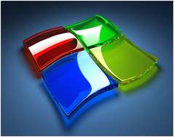



Mostly using Operating Systems
Mac OS by
Windows by
Linux by
Apple
Microsoft Corp.
Community

Slide 7
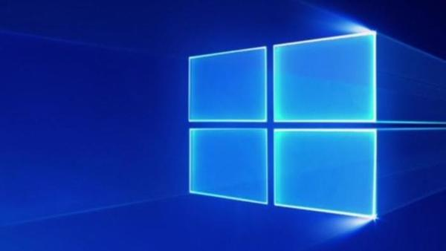
WINDOWS OS
Microsoft Windows operating system was developed by Microsoft to overcome the limitation of its own MSDOS operating system.
First successful version were Windows 3.0, released in 1990.
Subsequently released version were “Windows 95, Windows 98, Windows 2000, Windows XP, Windows XP Professional , Windows Vista, Windows 7, Windows 8, Windows 8.1 and nowadays Microsoft launches it’s latest OS Windows 10.”

Slide 8
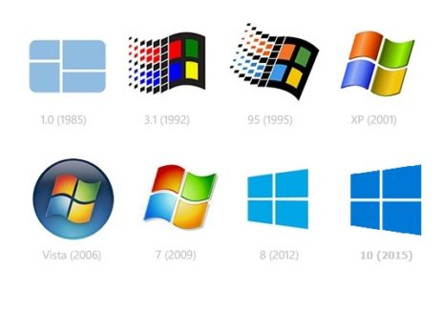
VERSION OF WINDOWS
Windows 10
Windows 8
Windows 7
Windows vista
Windows
XP
Windows 2000
Windows 98
Windows
95
Windows NT
Windows 1.0

Slide 9

WHAT IS LINUX ??
Linux is a free Unix-type operating system originally created by Linus Torvalds developed under the General Public License and the source code of which is freely available to every one.
LINUX kernel created by Finnish college student, Linus Torvalds in 1991.

Slide 10

VERSIONS OF LINUX
REDHAT
FEDORA
UBANTU
DEBIAN
KNOPPX
SUSE
SLACKWARE

Slide 11
Comparision
Windows OS
No Full Access on OS
Licensing Restrictions
No Command Line
Explicitly we need to Install Drivers
Flat File Systems
Threat detection is slow & fixing
patches takes 2 to 3 months
Paid help desk support
Paid Software's Eg. Ms Office
Linux OS
Full Access on OS
Licensing Freedom
Command Line
Inbuilt Drivers
Hierarchal file system
Threat detection & clearing threats
is very fast
Online peer support
Free Software's Eg. Libre office

Slide 12
Conclusion
In conclusion, no operating system is really better, the choice is up to you. If you're a gamer, then you have no choice, go for Windows. Programmers might prefer Linux and video/graphics producers will probablytend towards Mac. The best thing to do is probably to try each OS and see which is bestfor you!

Slide 13
THANK YOU
TAMIM HOSSEN SEFAT

